Slide 1
Context
Somass Chinook escapement target based on calculations using biostandards for fecundity at age:
 | Predicted Spawning Parameters
Age | %atAge | Fecundity | %Fem | PrespMort | Req Esc | Req Eggs | Predicted F by age | Proportion of eggs contributed
3 | 23% | 4000 | 7% | 0.8 | 5,756 | 1,289,438 | 403 | 3%
4 | 62% | 4400 | 50% | 0.8 | 15,513 | 27,302,818 | 7,756 | 70%
5 | 15% | 4800 | 75% | 0.8 | 3,614 | 10,407,745 | 2,710 | 27%
 |  |  |  |  | 24,883 | 39,000,000
More recent batch fecundity methods suggest values closer to 2500, 3700, and 4200, respectively.

Slide 2
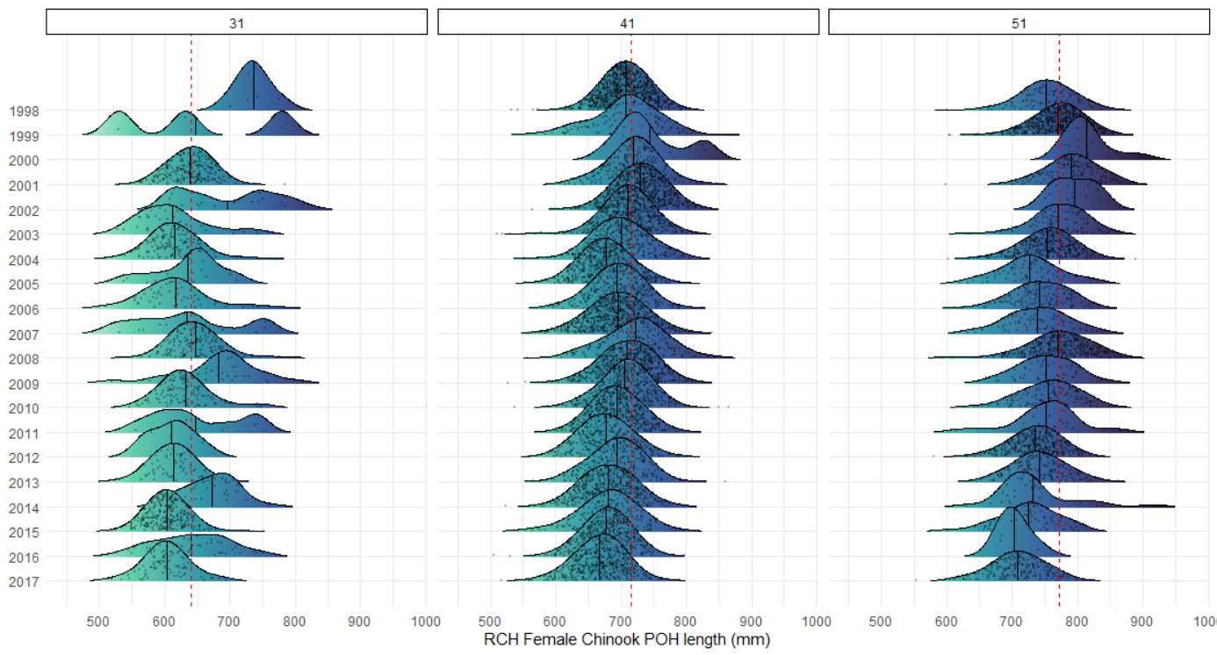
Size-at-age likely declining over time…
1998–2003 base period means

Slide 3
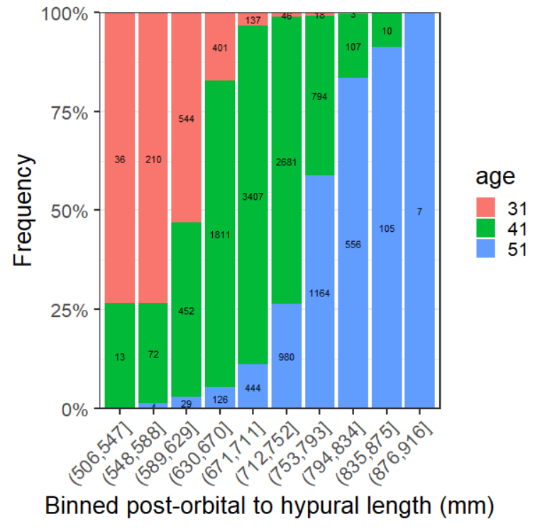
Target and realized sample sizes
Age comps by bin in historical data
Historical comps applied to 2021 samples
Bin | N | 31 | 41 | 51
(506,547] | 17 | 12 | 5 | 0
(548,588] | 16 | 12 | 4 | 0
(589,629] | 18 | 10 | 8 | 1
(630,670] | 19 | 3 | 15 | 1
(671,711] | 20 | 1 | 17 | 2
(712,752] | 16 | 0 | 12 | 4
(753,793] | 14 | 0 | 6 | 8
Total | 120 | 38 | 67 | 16

Slide 4
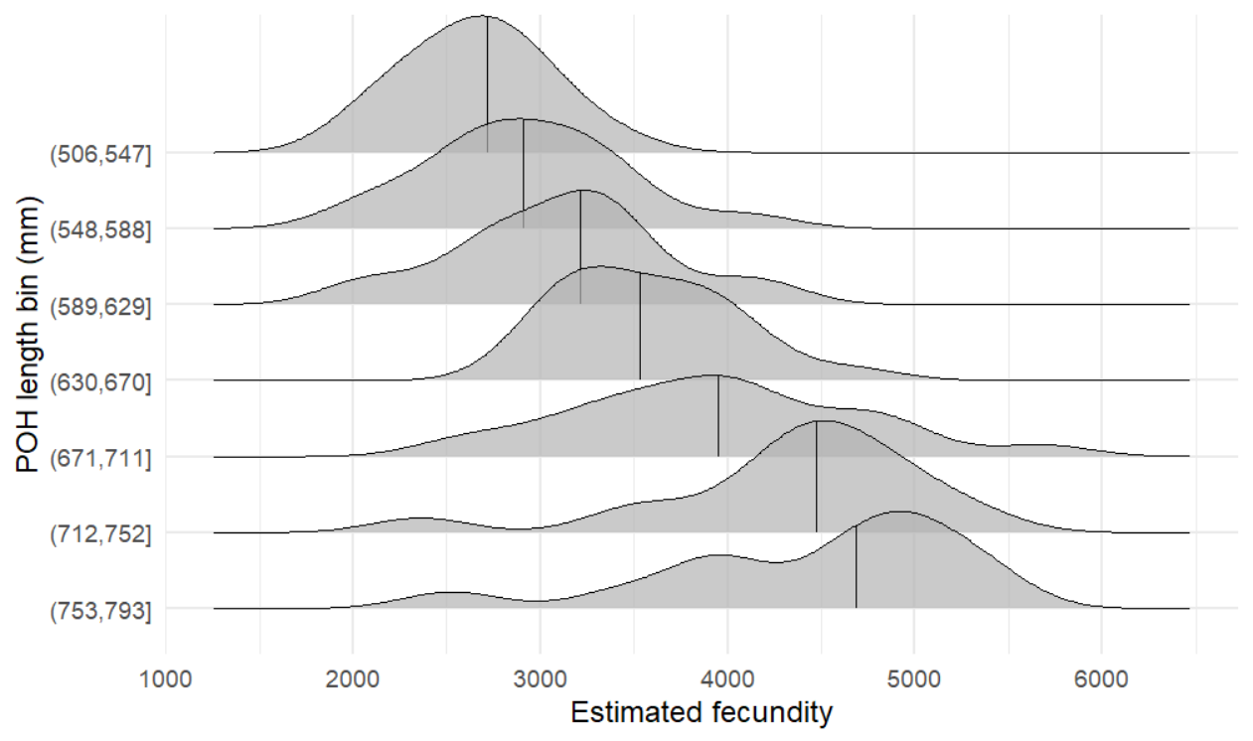
Results: fecundities per bin
2,718
2,908
3,212
3,528
3,952
4,474
4,688

Slide 5
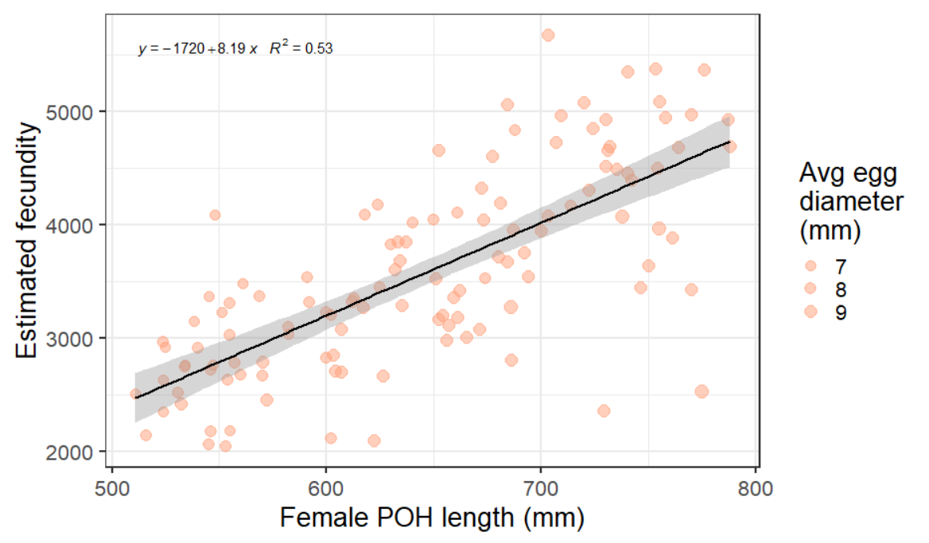
Results: fecundity–length relationship

Slide 6
Estimated fecundities using batch method and historical comps:
N | 31 | 41 | 51 | Median fecundity | 31_eggs | 41_eggs | 51_eggs
17 | 12 | 5 | 0 | 2,718 | 33,947 | 12,259 | -
16 | 12 | 4 | 0 | 2,908 | 34,164 | 11,713 | 651
18 | 10 | 8 | 1 | 3,212 | 30,685 | 25,495 | 1,636
19 | 3 | 15 | 1 | 3,528 | 11,497 | 51,923 | 3,613
20 | 1 | 17 | 2 | 3,952 | 2,715 | 67,525 | 8,800
16 | 0 | 12 | 4 | 4,474 | 888 | 51,771 | 18,924
14 | 0 | 6 | 8 | 4,688 | 598 | 26,372 | 38,662
Total | 38 | 65 | 16 |  | 114,494 | 247,059 | 72,285
Average |  |  |  |  | 3,008 | 3,773 | 4,391

Slide 7
If we then adjusted the calculations:
 | Predicted Spawning Parameters
Age | %atAge | Fecundity | %Fem | PrespMort | Req Esc | Req Eggs | Predicted F by age | Proportion of eggs contributed
3 | 23% | 3000 | 7% | 0.8 | 6,586 | 1,106,457 | 461 | 3%
4 | 62% | 3800 | 50% | 0.8 | 17,749 | 26,978,106 | 8,874 | 69%
5 | 15% | 4400 | 75% | 0.8 | 4,135 | 10,915,437 | 3,101 | 28%
 |  |  |  |  | 28,469 | 39,000,000

